Slide 1
A
Presentation On
OPPORTUNITY CIRCLE
Presented by:
Miss. Roopali Chaurasia
Guided by:
Miss. Shalini Kumari.
(Technical Trainer)
.
Java Full-Stack Development
EduBridge

Slide 2

Introduction
Limitation of Existing System
Motivation
Objectives
Problem Definition
Software Requierment
Output
Advantages
Conclusion

Slide 3

This project provides an opportunity to the Jobseekers/Student for finding training & placement as per their preference. It also has a feature in which companies who want to offer different courses and placement can provide their info and made available to the seekers.

Slide 4

For now the information is readable only i.e. the contact no will be available and student need to call and register themselves.
The online registration functionality is not available.

Slide 5

To provide a better user experience.
To maintain the various activities.

Slide 6

To study different management system.
To compare the proposed with existing system.
To develop a creative and logical thinking.
Improve the practical Knowledge.

Slide 7

Front end : Java.
IDE : Eclipse IDE

Slide 8

In this System following java concept are used
Switch cases
Loop
Methods
Array

Slide 9

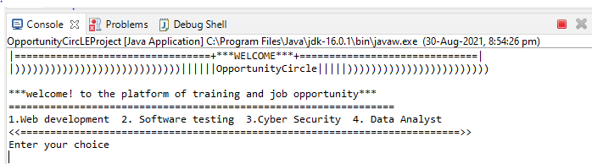
Welcome page

Slide 10

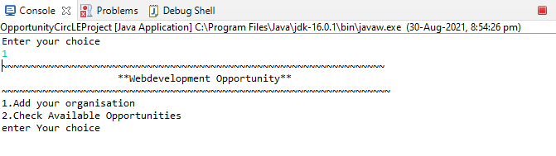

Slide 11

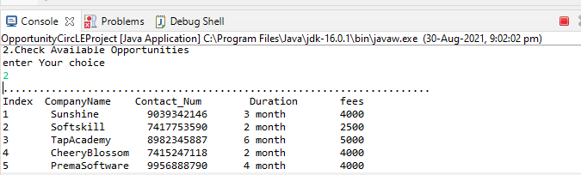


Slide 12
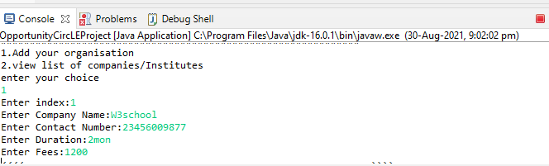

Slide 13
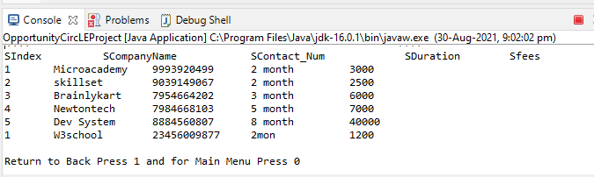

Slide 14

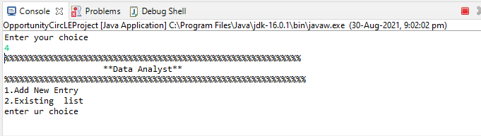

Slide 15
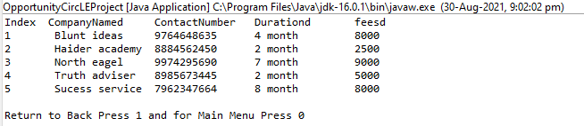

Slide 16

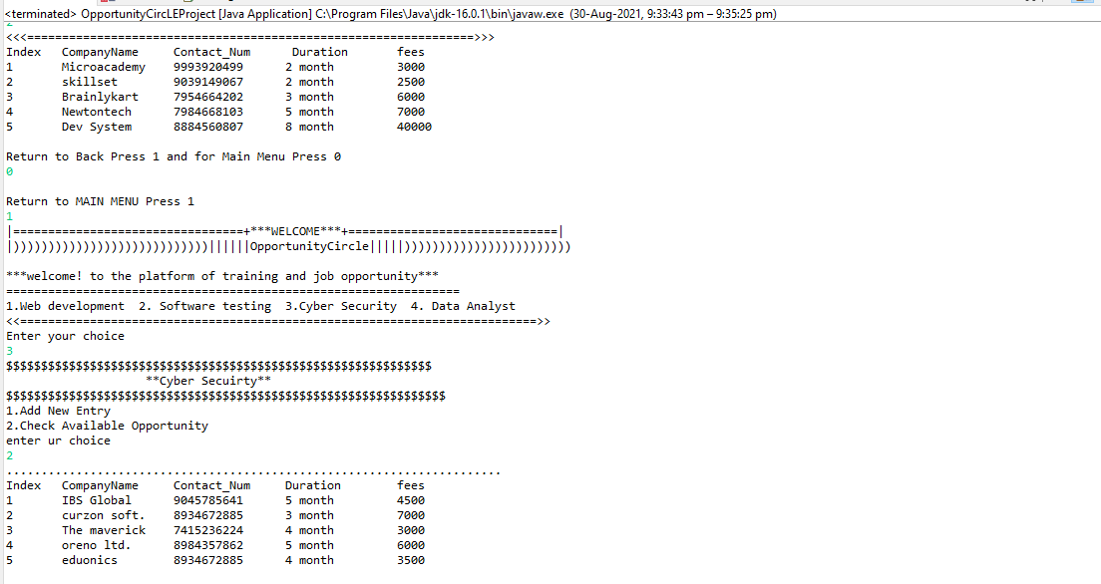

Slide 17

This system is proposed for students or jobseekers as a one stop destination for finding a opportunity.

Slide 18


